Slide 1
Update Progress
Project Operations Directorate
PT Mitra Transaksi Indonesia

Slide 2

Operational Technology Project
Project
Total Project
W3 | W4
UAT
20 | 21
Progress
20 | 21
Live
20 | 21
Cancel
20 | 21
REQUEST MITRATEX
149 | 149
0 | 0
5 | 3
142 | 145
1 | 1
CHANGEREQUEST MITRATEX
3 | 3
0 | 0
1 | 1
2 | 2
0 | 0
*Progress Request Mitratex akan selesai pada week 4
*Cancel untuk Scoring BTN,Bisa disetting saat tiket di analystnya BTN
Monitoring Closed Approved YOE Non LHF
CLOSED APPROVED
IN MAAS
PENDING MAAS
SINGLE BMRI
SINGLE BNI
SINGLE BRI
SINGLE BTN
111
101
10
39
0
50
0
SHARING
12

Slide 3
Update Project Status – Highlighted Project
Project
Total Project
Live
Progress
Hold
Drop
UREQ
47
4
33
2
8
UARF
92
92
0
0
0
INCIDENT
66
27
25
1
13
SR PROJECT
14
10
1
1
2

Slide 4
Update Project Status – Highlighted Project UREQ
Detail Project UREQ
Summary Project By Week
Growth 2 pada progress

Slide 5
Update Project Status – Highlighted Project UARF
Growth 16 pada progress

Slide 6
Update Project Status – Highlighted Project SR
Detail Project SR
Summary By Week
Growth 1 pada Done

Slide 7

Update Project Status – Highlighted Project Incident
Detail Project Incident
Growth 2 pada Done

Slide 8
Operational Technology Project

Slide 9
Budget – Asset Planning

Slide 10
Shortage EDC Base on Realistis Plan
Konven
Android
Kekurangan SPK 1 BNI Android (22.8K)
BNI
-
BNI
22.8K
Replace EDC Prio 1-4,
50% Prio 5-7 + NA
BMRI
57.7K
BMRI
-
Tidak ada target Android
Asumsi 25% dari Remaining Target
Asumsi 70% dari Remaining Target
Himbara
11.4K
Himbara
47.2K
Asumsi 20% dari Remaining Target
Member Bank
3.1K
Member Bank
2.1K
BSI
Buffer
-
Buffer
-
Konven : 72.2K
Total : 144,4K
Android : 72.2K
*Note Konven :
Shortage EDC tersebut, akan dipenuhi pada tahap I sebanyak 70K, Sisanya disesuikan dengan kebutuhan Management MTI

Slide 11
EDC Stock Alocated

Slide 12
EDC Stock Monitoring
Note : As of 29 Mei 2023, per end of Mei EDC APOS sudah di PO seluruhnya

Slide 13
Procurement Monitoring
No | Procurement |  | Status | Due Date
1 | ECR L Shape 7K |  | Penilaian Teknis | 16 Juni 2023
2 | EDC Konven + Android 70K |  | Circulate Approval Budget | W2 Juli 2023
3 | Cartridge SAM Card dan SIM Card |  | Procurement Process | 16 Juni 2023
4 | Purchase Order 7.5K FMS Android DX8000 |  | Circulate Approval | 16 Juni 2023
5 | Perpanjangan Jasa MS Jadin & Mahapay |  | Drafting | W3 Juni 2023
6 | Purchase Order 3.8K FMS Android APOS A8 |  | Done | 9 Juni 2023
7 | LKI EDC Android DX8000 |  | Drafting | 16 Juni 2023
8 | Annual Support SKI FutureX |  | Pending, tidak masuk RKAP | -
9 | Purchase Order Ke-empat Sticker EDC |  | Done | 06 Juni 2023
10 | Purchase Order Implementasi Aplikasi ESTIM -YOE |  | Done | 08 Juni 2023
11 | Purchase Order Ke-lima Sticker EDC |  | Circulate Approval BoD | 15 Juni 2023
12 | Pengembangan Platform WABA |  | Addendum Process
13 | Thermal Paper
14 | License Tableau Explorer 2023 |  | Pending, Perlu PnL
15 | Jasa MS 118K |  | Negosiasi 3 Pemenang | 23 Juni 2023

Slide 14
Payment or Budget Monitoring
No | Description |  | Status | Due Date
1 | SPKL Mei 2023 |  | Done | 09 Juni 2023
2 | Perdin Event Yogya Marathon |  | Done | 09 Juni 2023
3 | Perdin Event Java Jazz |  | Done | 09 Juni 2023
4 | Reimburse Pembelian Micro USB OTG |  | Finance Payment Process | 16 Juni 2023
5 | IP SAM Card Reader Ke-7 |  | Circulate Approval | 12 Juni 2023
6 | IP Indosat HiYokke Mei 2023 |  | Circulate Approval | 13 Juni 2023
7
8
9
10
11

Slide 15
Document Monitoring
No | Document |  | Status | Due Date
1 | Sertifikasi Kompetensi Bidang Sistem Pembayaran dan Pengelolaan Uang Rupiah (SPPUR) |  | Circulate Approval | 12 Juni 2023
2
3
4
5
6
7
8
9
10
11

Slide 16
PKS / SPK / PP Monitoring
No | Document |  | Status | Due Date
1 | Addendum PKS Ke-empat BRI |  | Done
2 | PKS Re-peat Order BNI Konven 38K |  | Done
3 | PKS QRIS Acquirer |  | Pending, tidak ada underdoc
4 | PP Newland Konven |  | Negosiasi Ketentuan
5 | PP MS 60K
6 | PP EDC Move 28K
7 | PP EDC Move 15K

Slide 17
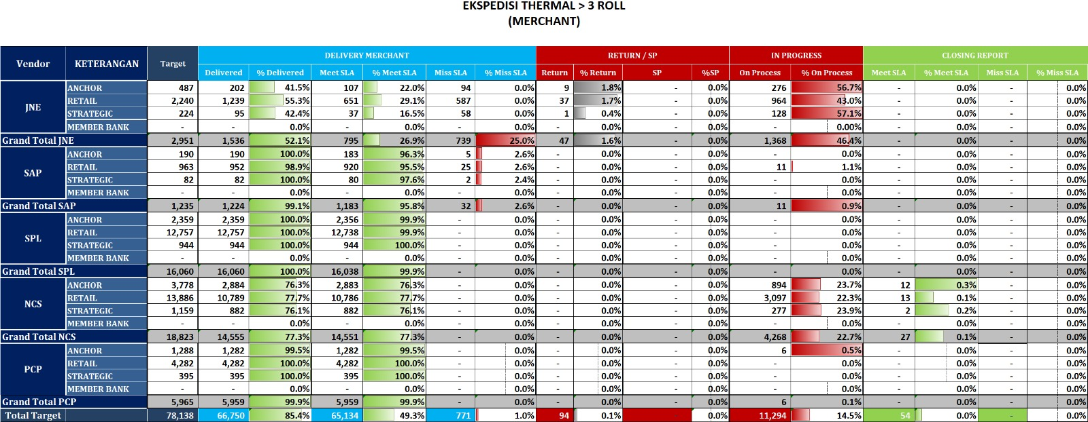
Thermal Monitoring
Note : JNE masih menunggu report lanjutan (Sulawesi dan Papua)

Slide 18
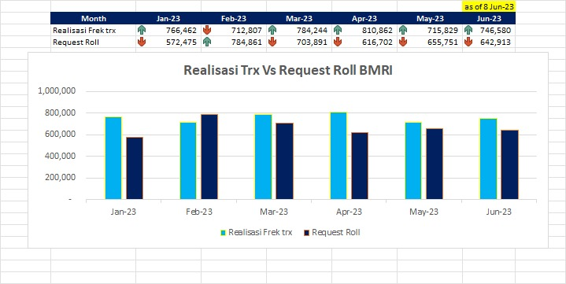
Thermal Monitoring
Note :
- Jan-23 - May-23 : Actual
- Jun-23 : Forcast

Slide 19
TMS Android
No | Action |  | Status | Timeline
1 | Approach Vendor (12 Vendor) |  | Done
2 | Requirement List |  | Done
3 | Demo |  | Done
4 | Shortlist Vendor (3 Vendor) – (GST, CSNA dan Urovo) |  | Done
5 | SOW |  | Review
6 | Scenario POC |  | Done
7 | POC |  | Done
8 | Q n A After POC |  | On Schedule | 20 - 22 Jun 2023

Slide 20
Proses Implementation &Resources Planning

Slide 21








Process & Implementation Planning
RPA Robotic Fase 1
Refund Manual, Manual Posting, dan
Bulk Manual Posting
Warehouse Management System
RPA Robotic Fase 2
Chargeback
Project Automation
Recon LinkAja Dynamic & Static
Mobile Apps & E- Learning
Submit Ticket, Omnichanel, Live Chat, Telephony, ChatBot, TalkBot, LMS, Read FAQ, Reward Redeem, dan Gamification
Vendor Billing Recon
Admin Fee EDC Recon
Reporting Activity Technician

Slide 22
Process & Implementation Planning
No. | Project Automation | Detail Project | PIC User | Update
1 | RPA Robotic Fase 1 | Refund Manual | Fadil | Testing OCR (17 sample surat diisi dengan manual)
 |  | Manual posting | Awal
 |  | Bulk Manual Posting | Ari
2 | RPA Robotic Fase 2 | Chargeback | Sandy | Request capture flow proses di MAAS
3 | Mobile Apps & E-Learnig | Submit Ticket | Bu Devi/Pak Ari | Review RFP
 |  | Omnichanel
 |  | Live Chat
 |  | Telephony
 |  | ChatBot
 |  | TalkBot
 |  | LMS
 |  | Read FAQ
 |  | Reward Redeem
 |  | Gamification
4 | Vendor Billing Recon |  | Mba Ikas | Gather Requirement
5 | Reporting Activity Technician |  | Mba Ikas | Gather Requirement
6 | Admin Fee EDC Recon |  | Mba Fifin | Gather Requirement
7 | Recon LinkAja Dynamic & Static |  | Mba Dewi | Gather Requirement
8 | Warehouse Management System |  | Team Aset | Not Started

Slide 23
Operation Policies

Slide 24

Thank you

